Slide 1
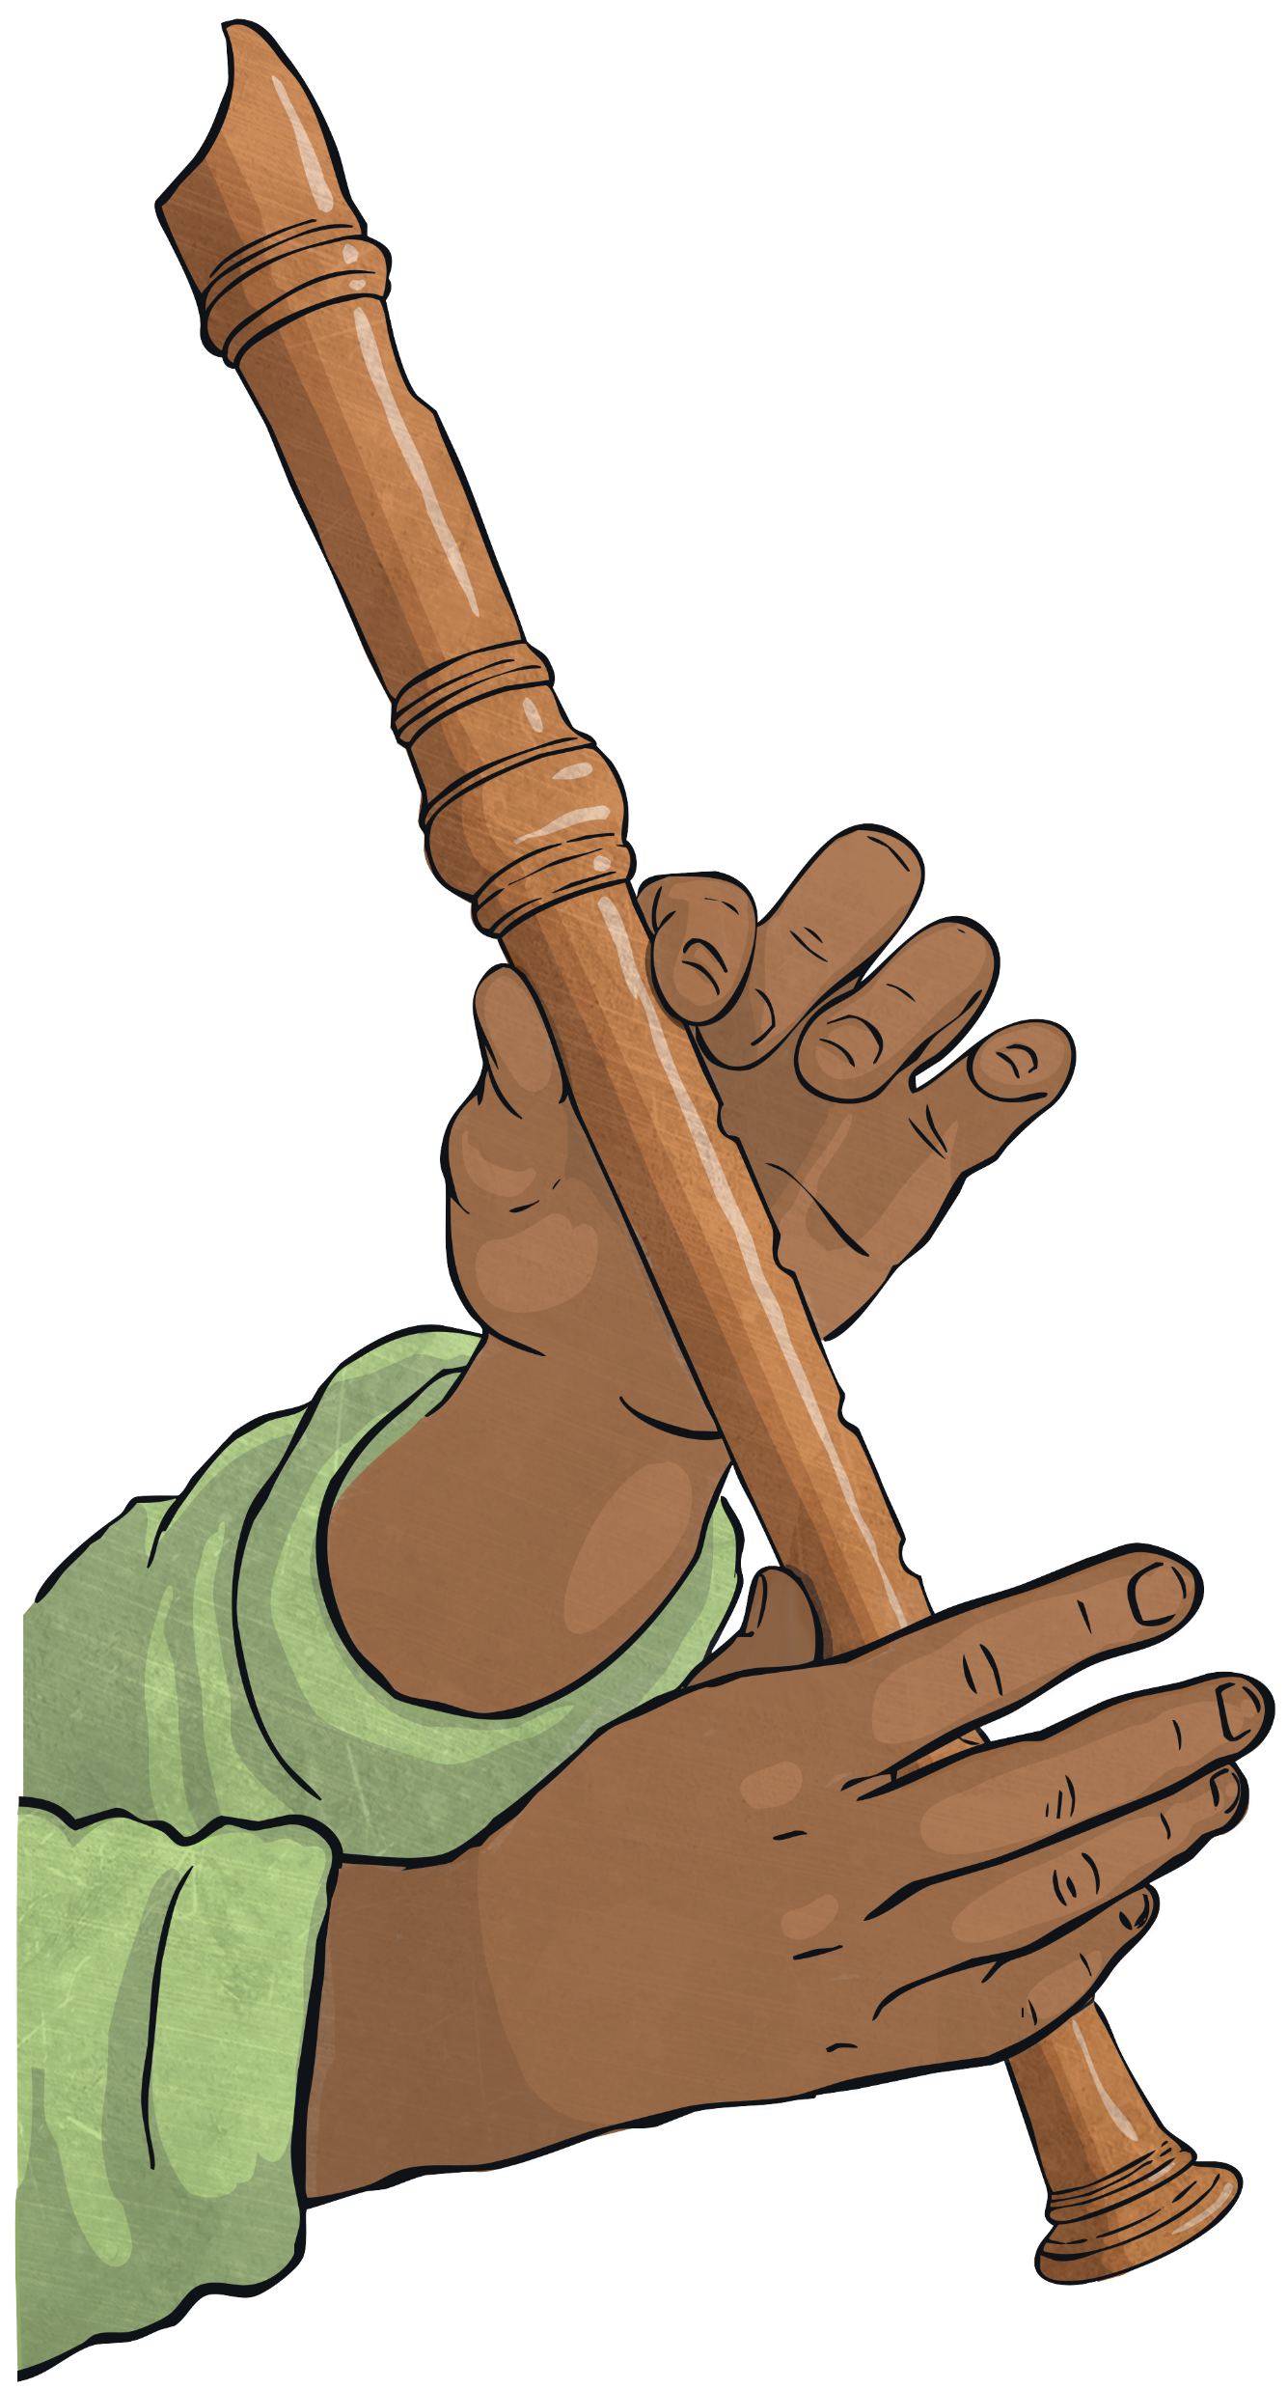
Walt
Play the recorder musically.

Slide 2
Wilf
My left hand is on top.
My fingers are covering the correct holes.
The finger holes are completely sealed.
My air steam is gentle and steady.
I am using my tongue to separate the notes as I play them.
I can read the notes B, A and G.
I can play rhythms accurately.

Slide 3
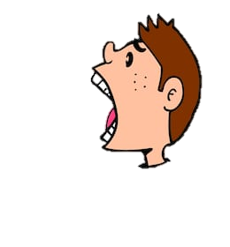
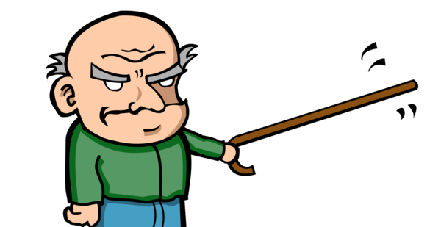
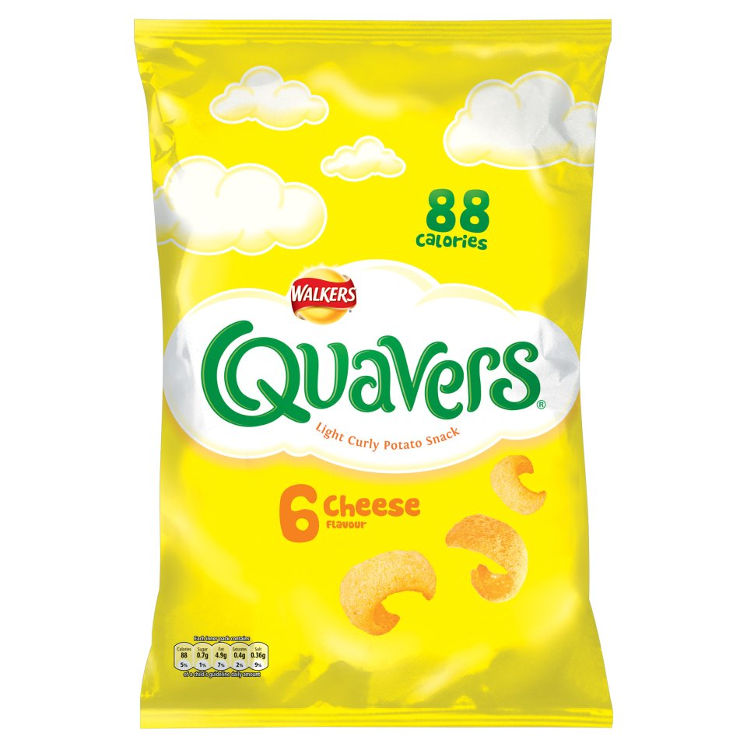
Semibreve
4 beats
Minim
2 beats
Crotchet
1 beat
Quavers
1 beat
Semiquavers
1 beat

Slide 4
B
My left hand is on top.
My fingers are covering the correct holes.
The finger holes are completely sealed.
My air steam is gentle and steady.
I am using my tongue to separate the notes as I play them.

Slide 5
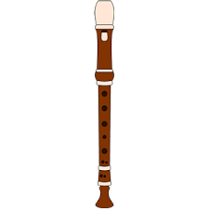
4
4
Glory B
4
4
4
4
4
4

Slide 6
4
1 2 3 4 1 2 3 4
4
BB Blues
4
4
4
4
4
4

Slide 7
A

Slide 8
1 2
4
4
1 2 3 4 1 2 3 4
Thinking
4
4
4
4
4
4

Slide 9
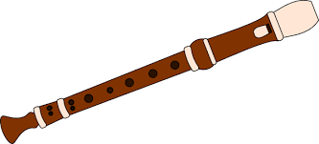
4
4
4
4
Wet and Windy
4
4
4
4

Slide 10
4
4
4
4
How about this
4
4
4
1 2
4

Slide 11
Need to know information
P Piano - Play softly
F Forte - Play Loudly
D.S. (dal segno) – Go to the sign
Fine - Finish
D.S al Fine - Go back to the sign and end at the Fine.

Slide 12
4
4
4
Fine
4
Razza Sazza
4
x3
4
4
D.S al Fine
4

Slide 13
4
4
4
Skat Cat Swing
Fine
D.S al Fine

